Slide 1


Y11 Study
Golden Folder
Valuable Independent Study
Making it easy for you to know what they need to do
Making it easy for home to know your achievements

Slide 2
Did you know?
This year group could go down as the brightest in this school’s history?
This year we have seen;
Improved overall outcomes
Improved engagement
Great ambition in many of you
Enthusiasm from teachers to support you.
We want to give you every opportunity to succeed.
Therefore, we’re implementing an ambitious, supportive, intelligent, program to maximise your chances of success;

Slide 3

Y11 – Study Provision

Slide 4
Your Provision
Golden Folder
A central storage for your;
Progress
Timetabling
Tracking
Revision
Independent Study
A clear timetabling of your after-school provision
Intervention Attendance
Independent Study
Making it easy for the child to know what they need to do
Making it easy for the parent to know what their child has done

Slide 5
The Golden Folder
You will carry this throughout the academy
It will direct your revision clearly
Teachers will review what you have done, and mark that they have reviewed the completed work
Completing work will result in Prom Points
The tasks that have been built will directly help you with your December PPEs
Making it easy for you to know what to do.
Making it easy for teachers to reward your efforts.

Slide 6
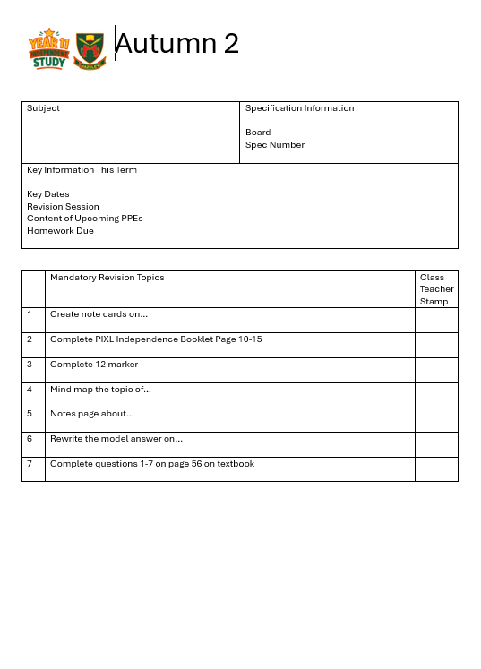
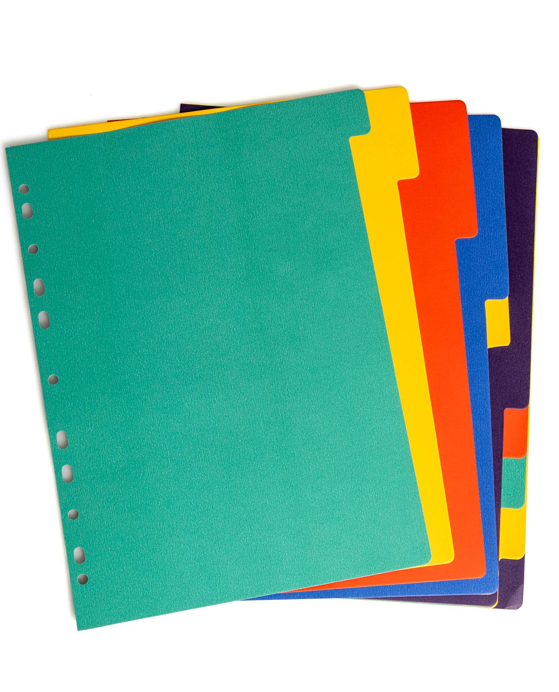
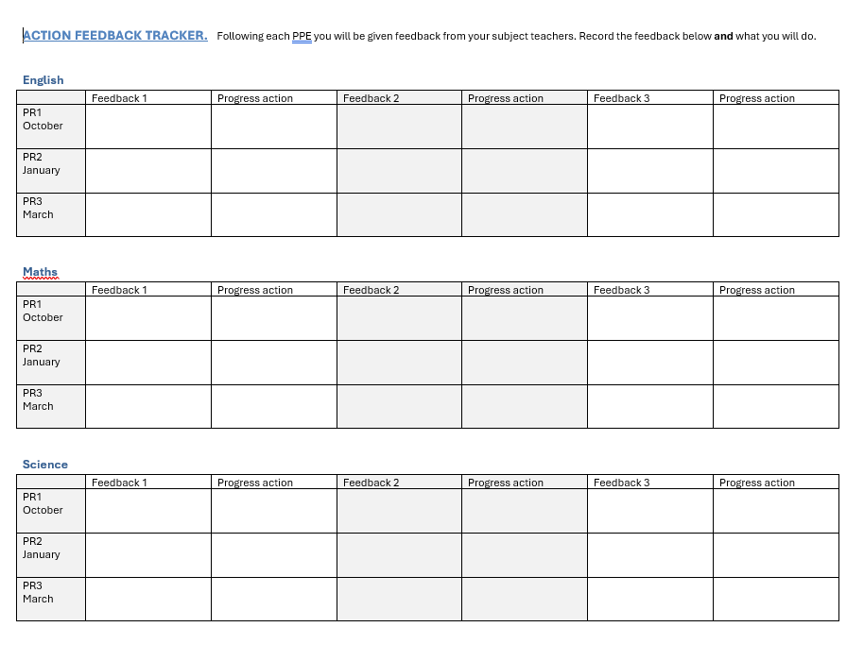
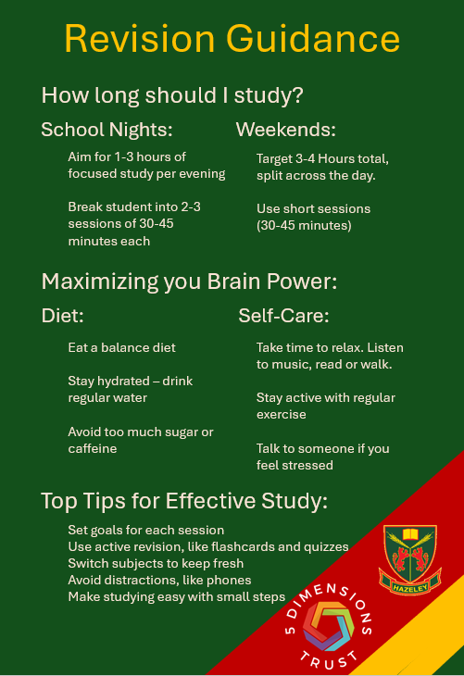
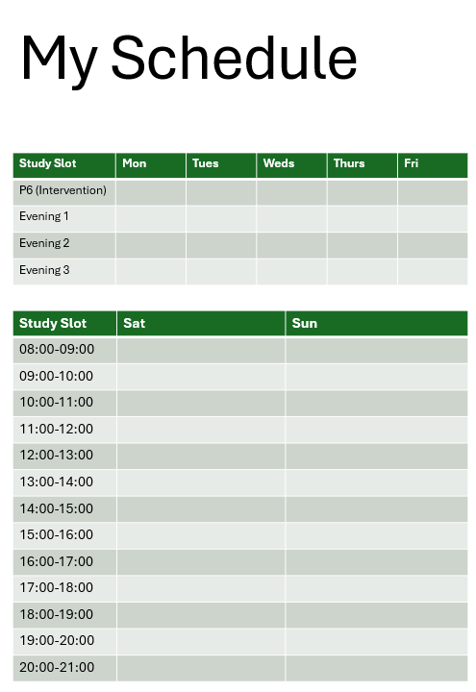

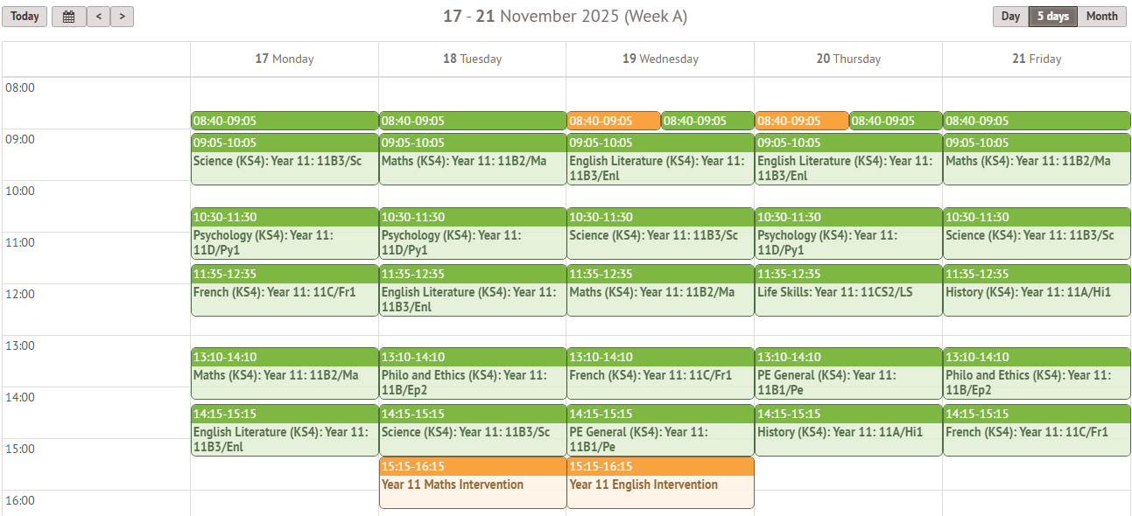
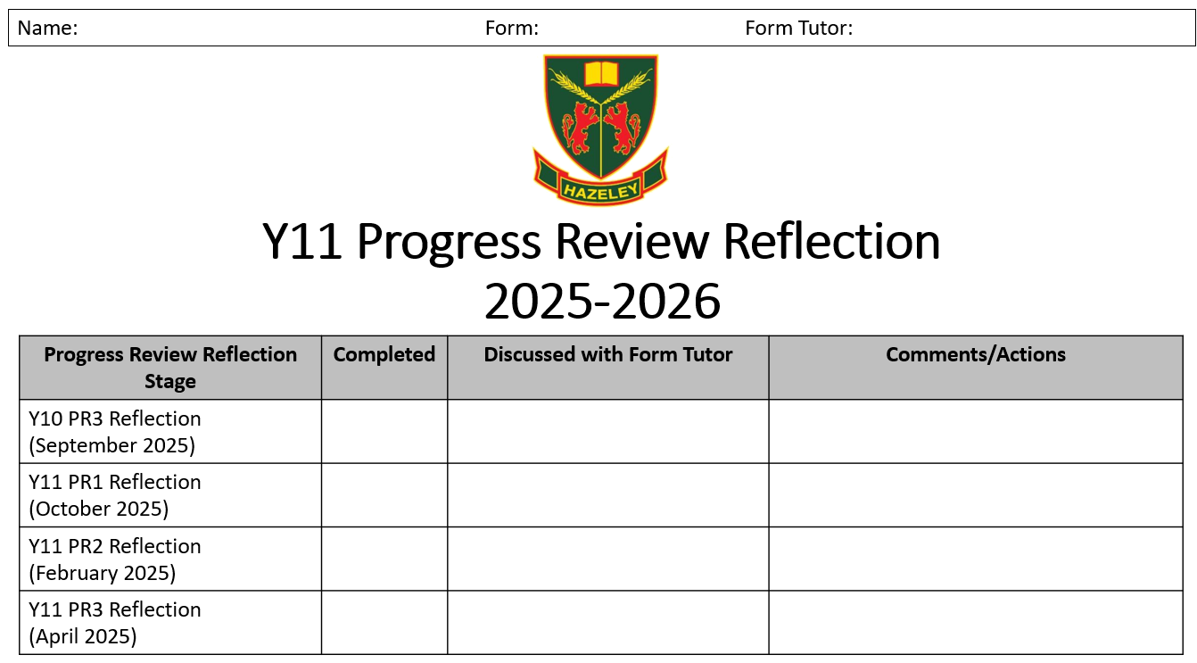
Your Golden Folder
Write your first and surname on the front and side of your Golden Folder
  Also write your form, and form tutor’s name.
Open your Golden Folder. The documents will go in the following order:
Front Cover
Your metacognitive reflection form
Your PR2 Report (will go here)
Your first divider
Your timetable (will go here)
Your revision timetable
Your revision guidance
Your Action Feedback tracker
Your second divider
Your mandatory tasks per subject (will go here)

Slide 7
Maximising Data - Tracking
Stage 1:
Using your reports, you’ll be assigned teachers to you based on how off-track you are.
Different teachers will tell you if they’re working with you.
You may need to go to a different room on a Friday to see a specific teacher.
What does the teacher do?
Review your Golden Folder, and whether you’re getting your tasks signed off.
Contact home to praise/provide feedback on how things are going
Check in with you to see how you’re finding the revision process
Reward you with Prom Points
Contact home to communicate excellence/concern
This will help you to maximise all of your outcomes based on your needs.

Slide 8
Intervention - Targeted
You will be given a timetable of places to be for Period 6.
This will be either;
A specific subject, to focus on helping you to secure a specific grade
IS – which is a silent study space for you to complete specified work.
The expectation is you attend, and we will be tracking to see your engagement.
Attendance results in Prom Points, and will directly improve your outcomes in December PPEs
Making it easy for you to focus on where to be, and what to do.

Slide 9
What’s in it for you?
You get the support you need based on your academic progress
Teachers will confirm that what you’re doing is helping to reach your goals
You will find it easy to tell your parents/teachers what you’ve done.
For everything you do, you’ll receive Prom Points (Y11 Study)
Broader rewards will happen for those who are engaging exceptionally.

